Slide 1


Skin Cancer Diagnosis Using Deep Convolutional Neural Network
CSE438 - Applied Data Science for Practitioners
Project - Group 01

Slide 2

Group Members
Md. Farhadul Islam (19201086)
Fardin Bin Rahman (20101592)
Sarah Zabeen (19241004)
Md. Azharul Islam (19301257)

Slide 3
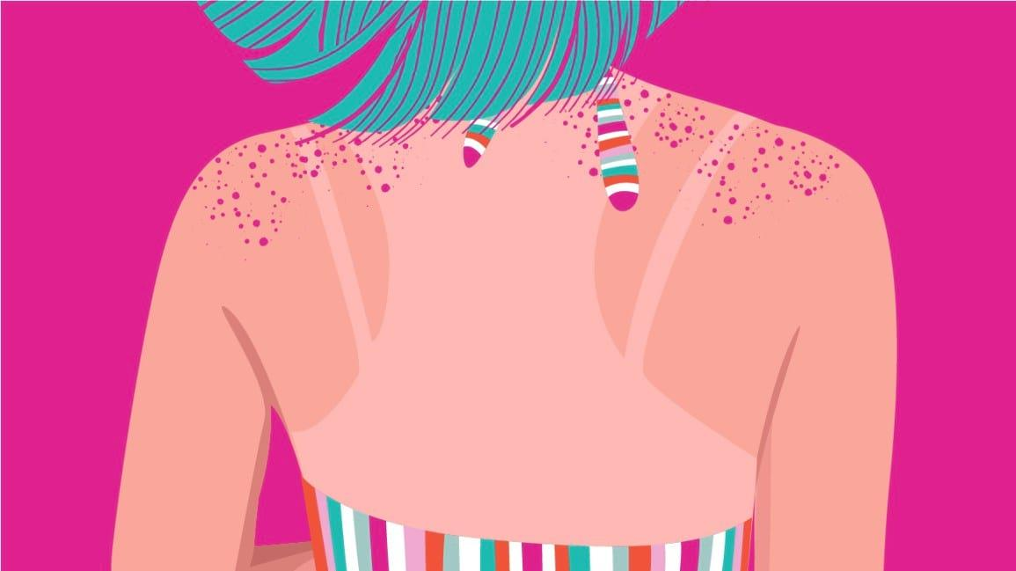
Introduction
Skin Cancer is an invasive disease
Across the world, skin cancer accounted for over 1 million deaths every month, and 300,000 more monthly cases in 2018 [2]
Progress in Deep Learning
Reportedly the accuracy for properly diagnosing skin lesions by professionals is below 80% [17]
3 Categories of Skin Cancer [3]
Fardin

Slide 4
Introduction
Our main contributions are:
• Using CNN to classify seven distinct categories diseases with high accuracy.
• Creating a lightweight, user friendly model for applications.
Fardin

Slide 5
Related Work
First studies using dermoscopy images were limited
Convolutional neural networks became the preferred choice for skin cancer classification
Current literature uses transfer learning
Previous studies of computational classification were unable to improve the accuracy of MCS skin cancer classification
Most of the researches done has not used large dataset
Our proposed model performs much better on seven classes of skin cancer
Fardin

Slide 6
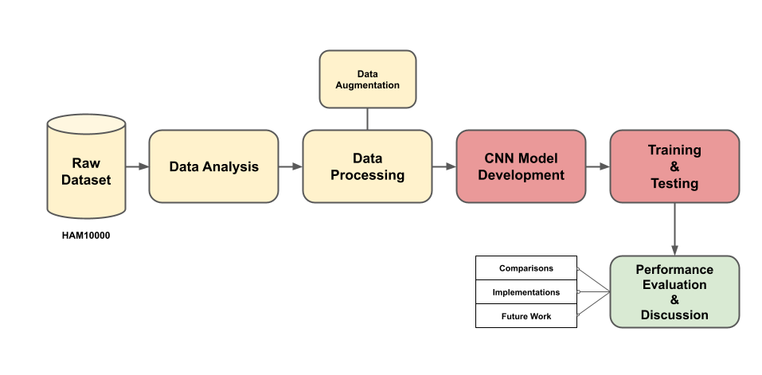
Research Methodology - Workflow
Fardin

Slide 7
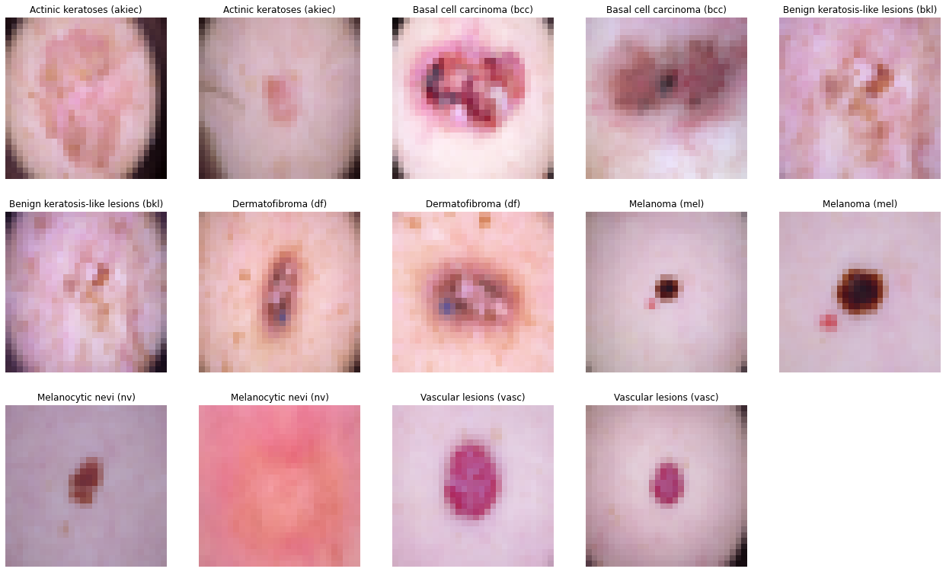
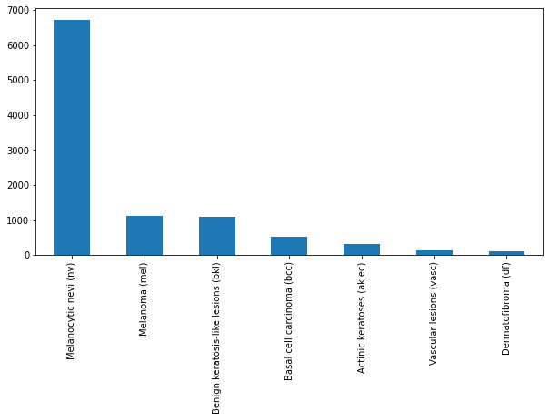
Research Methodology
Dataset: HAM10000 [10]
Classes : 7
115 images of Dermatofibroma
142 images of Vascular Lesions
327 pictures of Actinic keratosis
514 images of Basal cell carcinoma
1099 pictures of Benign keratosis
1113 images of Melanoma
6705 images of Melanocytic nevi.
Fardin

Slide 8
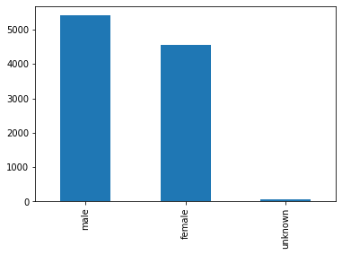
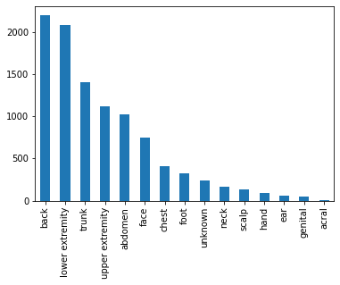
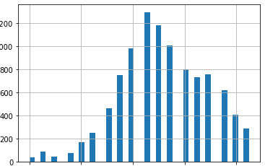
Research Methodology
Exploratory Data Analysis:
Fardin

Slide 9
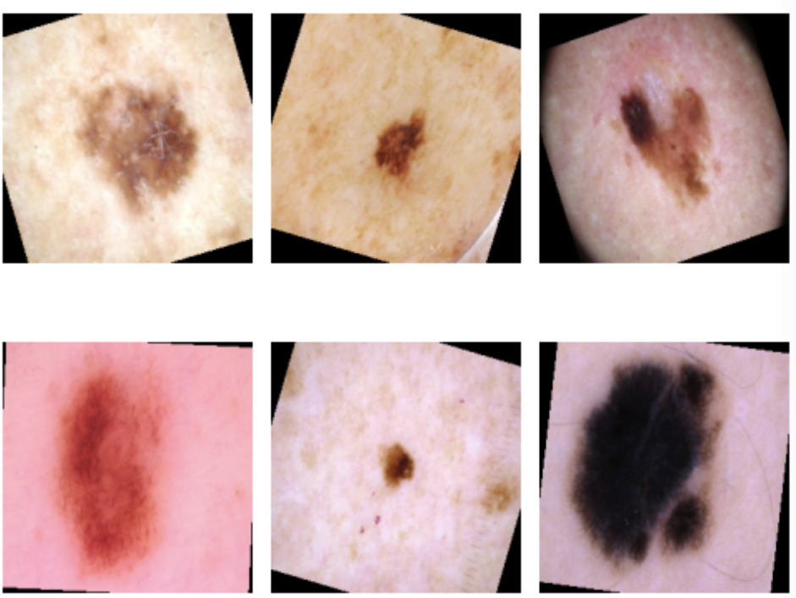
Research Methodology
Data Processing:
Replacing Null with Mean Values
Resizing image 28*28
Data Splitting: 60:20:20
Augmentation
Rotation
Width Shift
Height Shift
Shear
Horizontal & Vertical Flip
Azhar

Slide 10
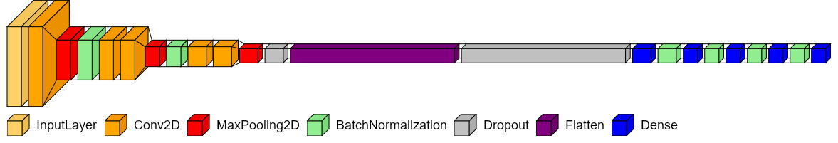
Research Methodology
5 Convolutional Layers, with MaxPooling and BatchNormalization - as a block
Fully Connected Layer - Serially Decreasing nodes
15% Dropout to reduce overfitting, after Convolutional block and after flattening into 1 Dimensional Data
Finally Comes the output layer with 7 nodes.
Farhad

Slide 11
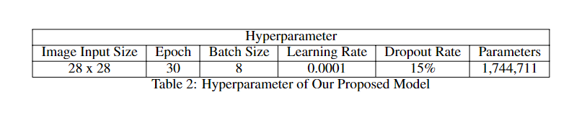
Research Methodology
We select the values according to the obtained results
Here, the dropout helps us in reducing the overfitting and resulting in a smoother train vs validation curve.
We use callback function, to early stop the training. The epoch is set to 50, but it stops somewhere between 30 to 37 max.
Farhad

Slide 12
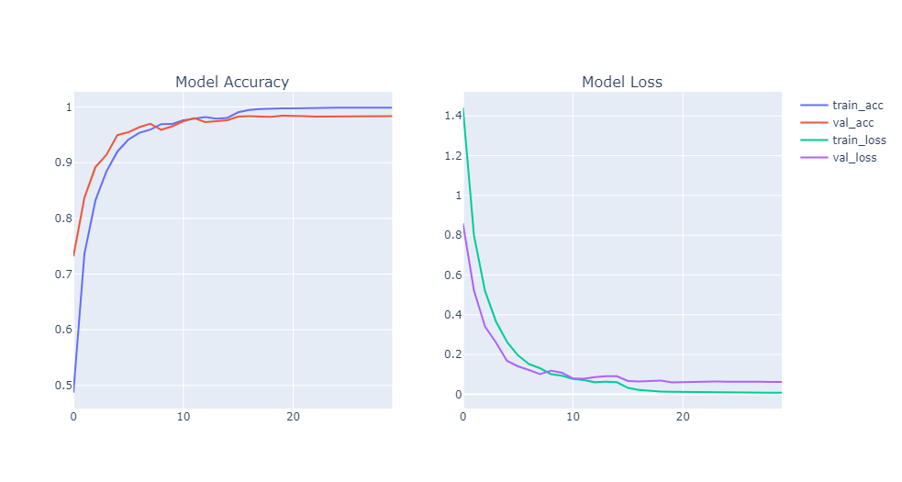
Research Methodology - Experimental Evaluation
Farhad

Slide 13
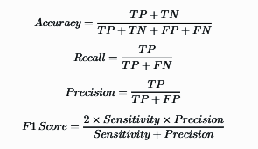
Experimental Evaluation
Evaluation Metrics:
Accuracy
Recall
Precision
F1-Score
Sarah

Slide 14
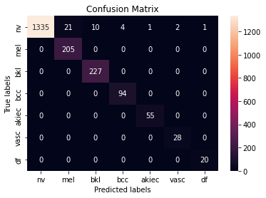
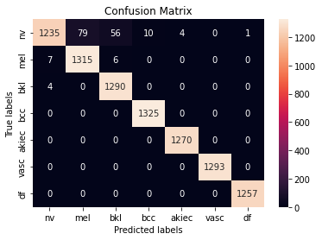
Experimental Evaluation
Data | Accuracy | Precision | Recall | F1-Score
Original | 98.053% | 96% | 100% | 98%
Augmented | 98.4% | 98% | 98% | 98%
Sarah

Slide 15
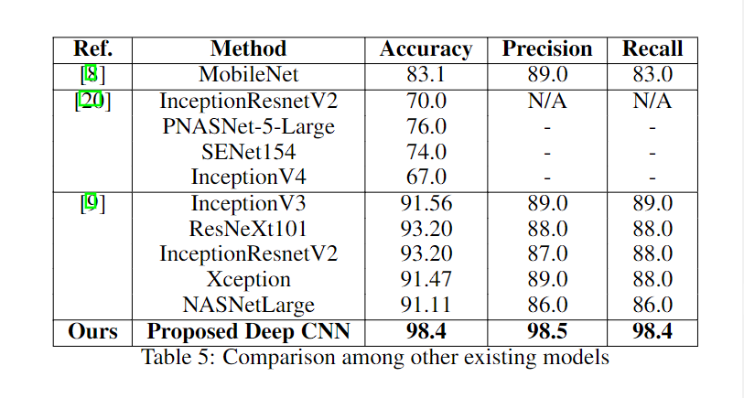
Experimental Evaluation
Sarah

Slide 16

Discussion
Model performs well with comparatively large value of kernel size in the input Conv2D layer
Fully Connected Layers in decreasing series
Comparatively Lightweight Model
Web & App Implementations
Azhar

Slide 17
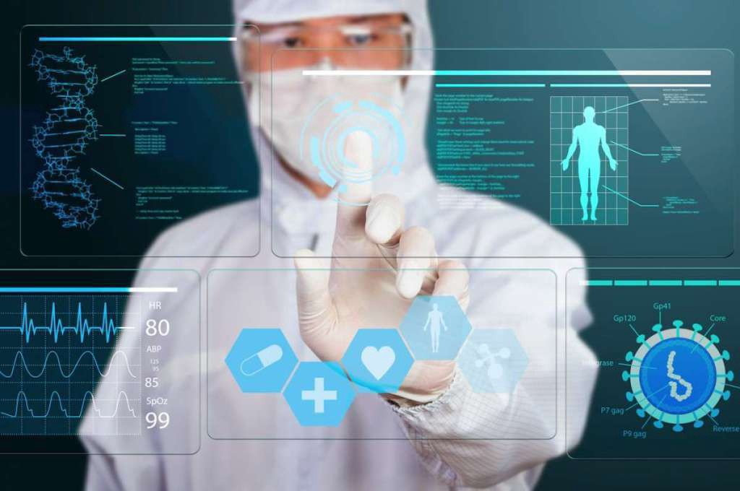
Conclusion and Future Work
Number of skin cancer cases are increasing every day
Addressing this global issue
Recent Progress in Deep Learning enables efficient computer aided diagnosis
Our Proposed Model outperforms other popular methods
Interpretable Diagnosis and Explainable AI
Uncertainty Quantification
Azhar

Slide 18
References
[2] Skin cancer statistics | World Cancer Research Fund International, . URL - https://www.wcrf.org/cancer-trends/skin-cancer-statistics/
[3] Skin Cancer | Skin Cancer Facts | Common Skin Cancer Types, . URL - https://www.cancer.org/cancer/skin-cancer.html
[8] Saket S. Chaturvedi, Kajol Gupta, and Prakash S. Prasad. Skin lesion analyser: An efficient seven-way multi-class skin cancer classification using mobilenet. ArXiv, abs/1907.03220, 2019.
[9] Saket S. Chaturvedi, Jitendra V. Tembhurne, and Tausif Diwan. A multi-class skin cancer classification using deep convolutional neural networks. Multimedia Tools and Applications, pages 1 – 22, 2020
[10] Noel Codella, Veronica Rotemberg, Philipp Tschandl, M. Emre Celebi, Stephen Dusza, David Gutman, Brian Helba, Aadi Kalloo, Konstantinos Liopyris, Michael Marchetti, Harald Kittler, and Allan Halpern. Skin lesion analysis toward melanoma detection 2018: A challenge hosted by the international skin imaging collaboration (isic), 2019. URL- https://arxiv.org/abs/1902.03368
[17] R. Marks. Epidemiology of melanoma. Clinical and Experimental Dermatology, 25(6):459–463, September 2000. ISSN 0307-6938. doi: 10.1046/j.1365-2230.2000.00693.x.
[20] Md Ashraful Alam Milton. Automated skin lesion classification using ensemble of deep neural networks in isic 2018: Skin lesion analysis towards melanoma detection challenge. ArXiv, abs/1901.10802, 2019.

